Slide 1
Chongqing University of Technology
ATAI
Advanced Technique of Artificial Intelligence
Chongqing University of Technology
ADAGCN: ADABOOSTING GRAPH CONVOLUTIONAL
NETWORKS INTO DEEP MODELS（ICRL_2021）
Anonymous authors
2021.3.9 • ChongQing
Reported by LeLe Duan
Code&dataset:None

Slide 2
Chongqing University of Technology
ATAI
Advanced Technique of Artificial Intelligence
Chongqing University of Technology
1.Background
2.Method
3.Experiments
4.Conclusion

Slide 3
Background
Almost all of GNN models have shallow model architectures with only two or three layers
Over-smoothing problem limits GCN get features from remote hops of neighbors for current nodes
Intuitively, the desirable representation of node features does not necessarily need too many nonlinear transformation f applied on them
Simplified Graph Convolution (SGC):
Insufficient power in representing information of high-order neighbors
AdaGCN:

Slide 4
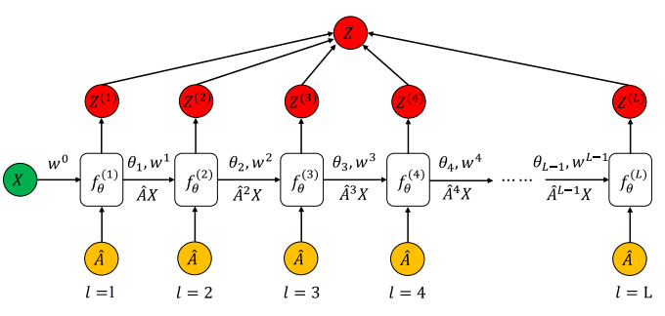
Method
AdaGCN
SAMME算法
SAMME.R算法
$$Z^{(l+1)}=f_{θ}\left({\hat{A}}^{l}X\right)$$
$$Z^{(l+1)}=f_{θ}\left({\hat{A}}^{l}X\right)$$

Slide 5
Experiment
Dataset：

Slide 6
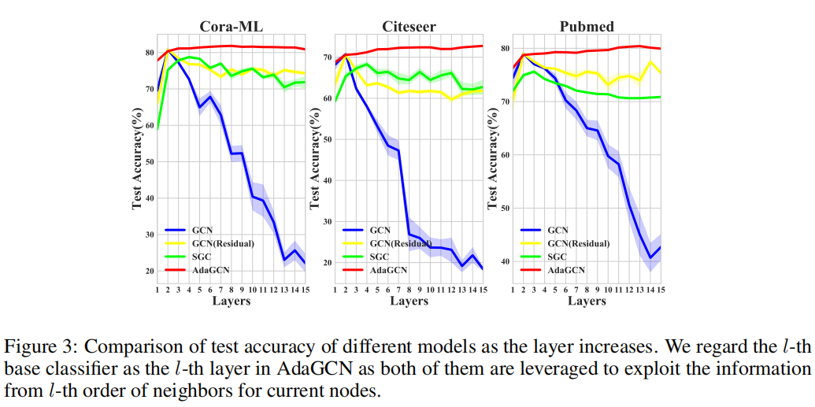
Experiment

Slide 7
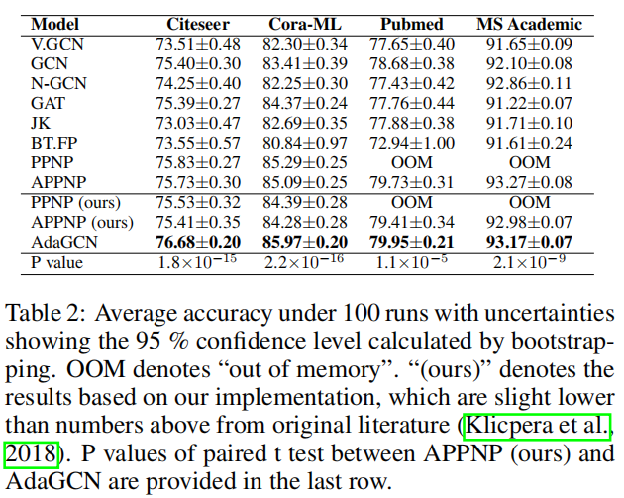
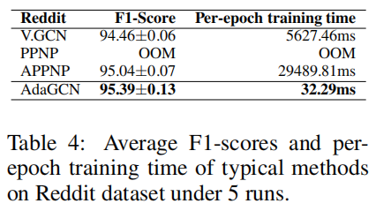
Experiment
Overall Study
Cora
siteseer
pubmed

Slide 8
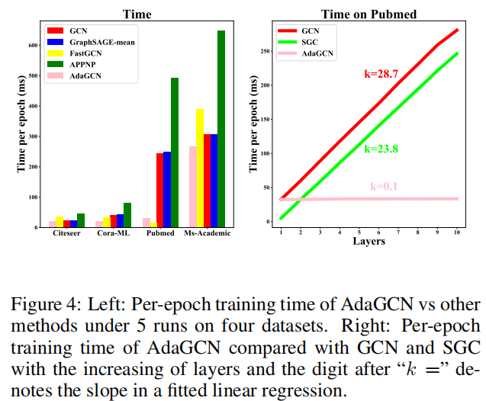
Experiment
Computational Efficiency

Slide 9
Chongqing University of Technology
ATAI
Advanced Technique of Artificial Intelligence
Chongqing University of Technology
Thank you!

